Slide 1
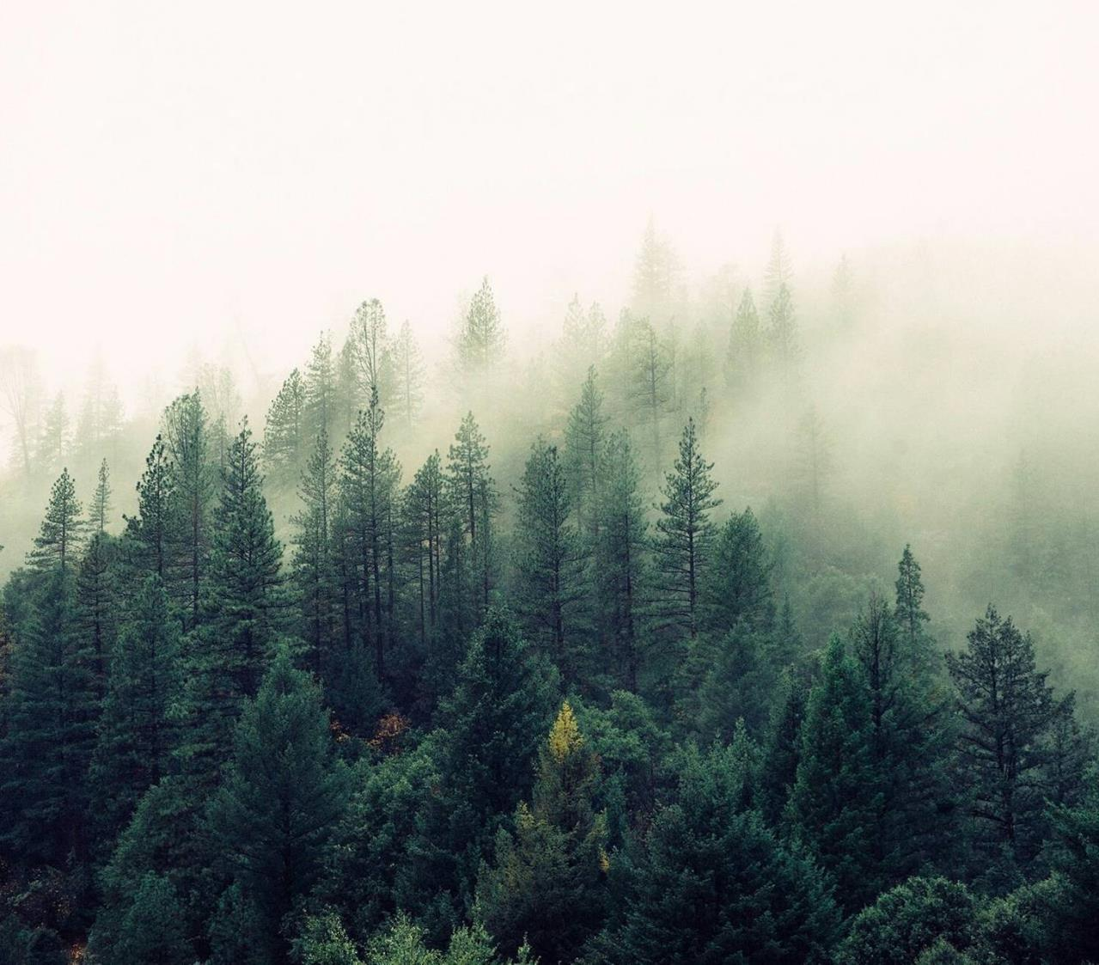
Image Processing Project
Oleksander glushko
Dmytro Razvaliaiev
Vistula University
2023

Slide 2
Agenda
We are implementing different technics of image processing including:
Blurring via Gaussian, Box, and Zero Kernel algorithms;
Image Enhancement via Gamma Correction, 2d-filtering using different kernels: edge detection, sharpen, identity filter, zero kernel;
Median filtering;
Wavelet and Fourier Transformations.

Slide 3
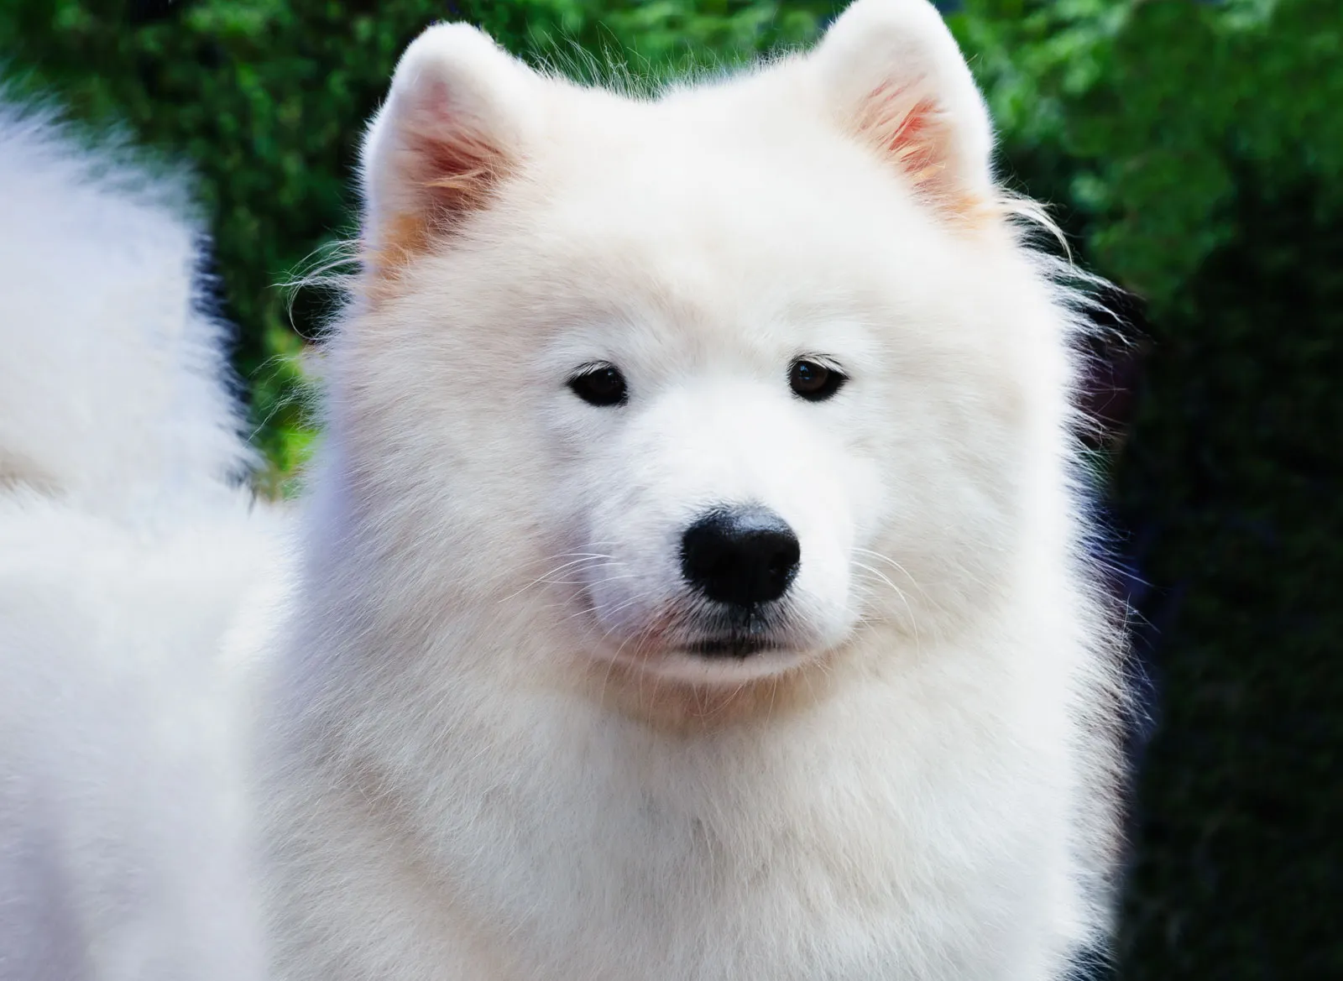

Blurring Filter

Slide 4
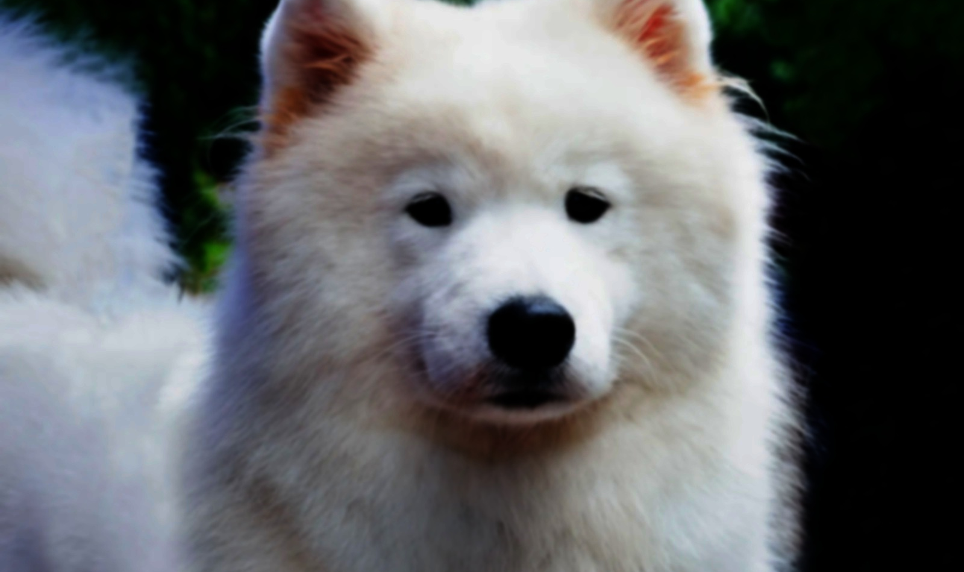
Gamma Correction

Slide 5
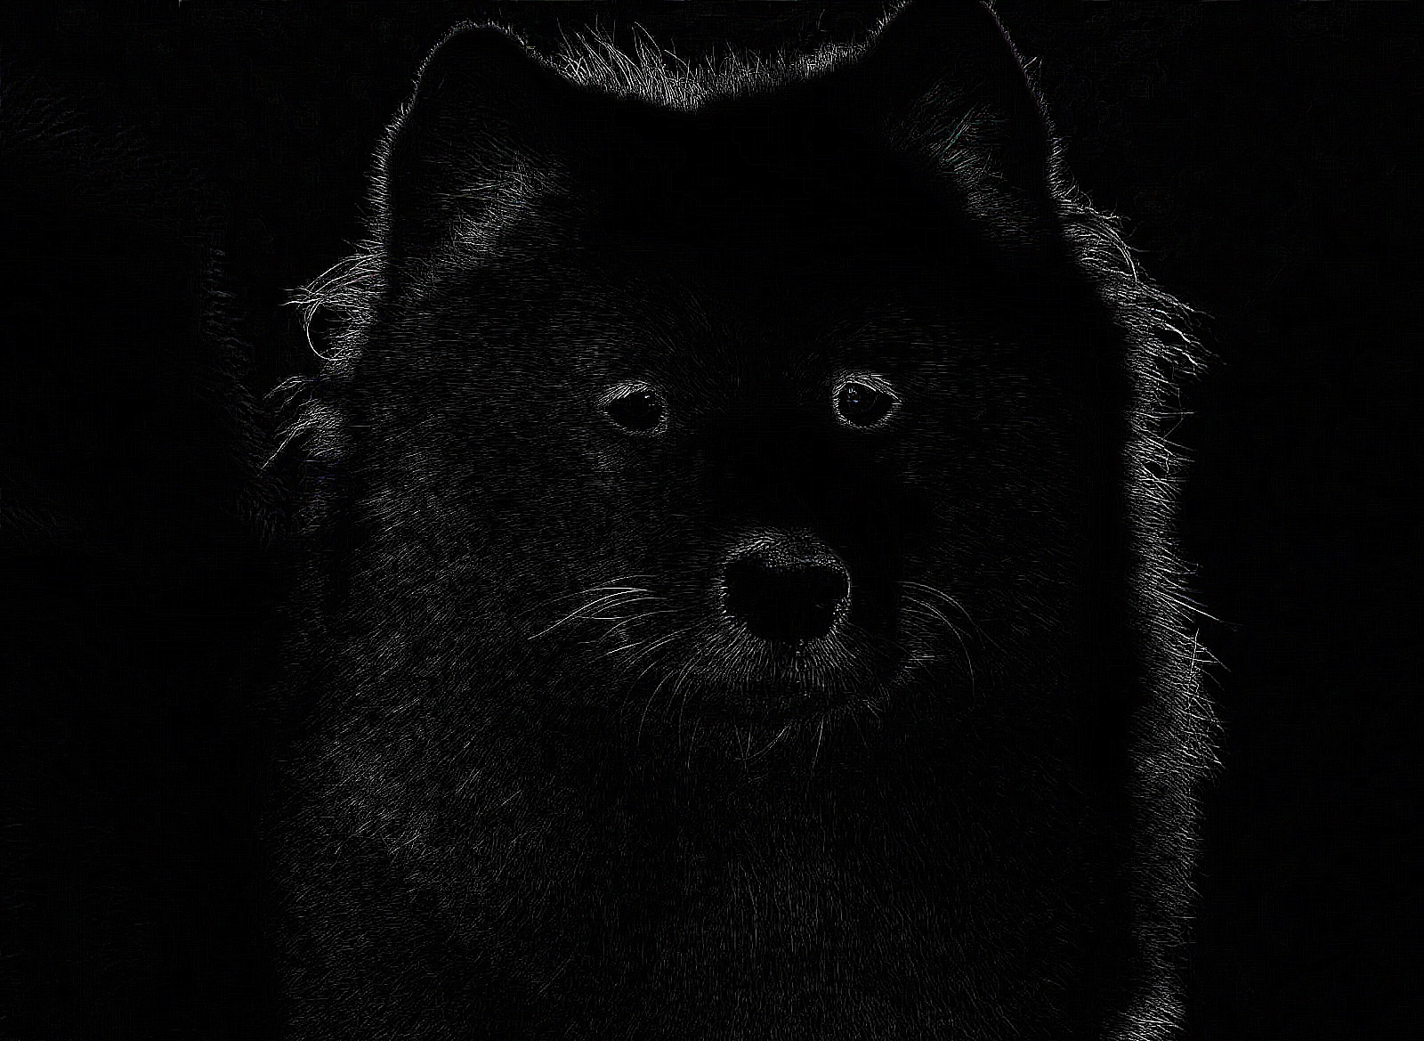


2d-filtering with different kernels
Edge Detection
Gaussian Blurring
Identity Matrix

Slide 6
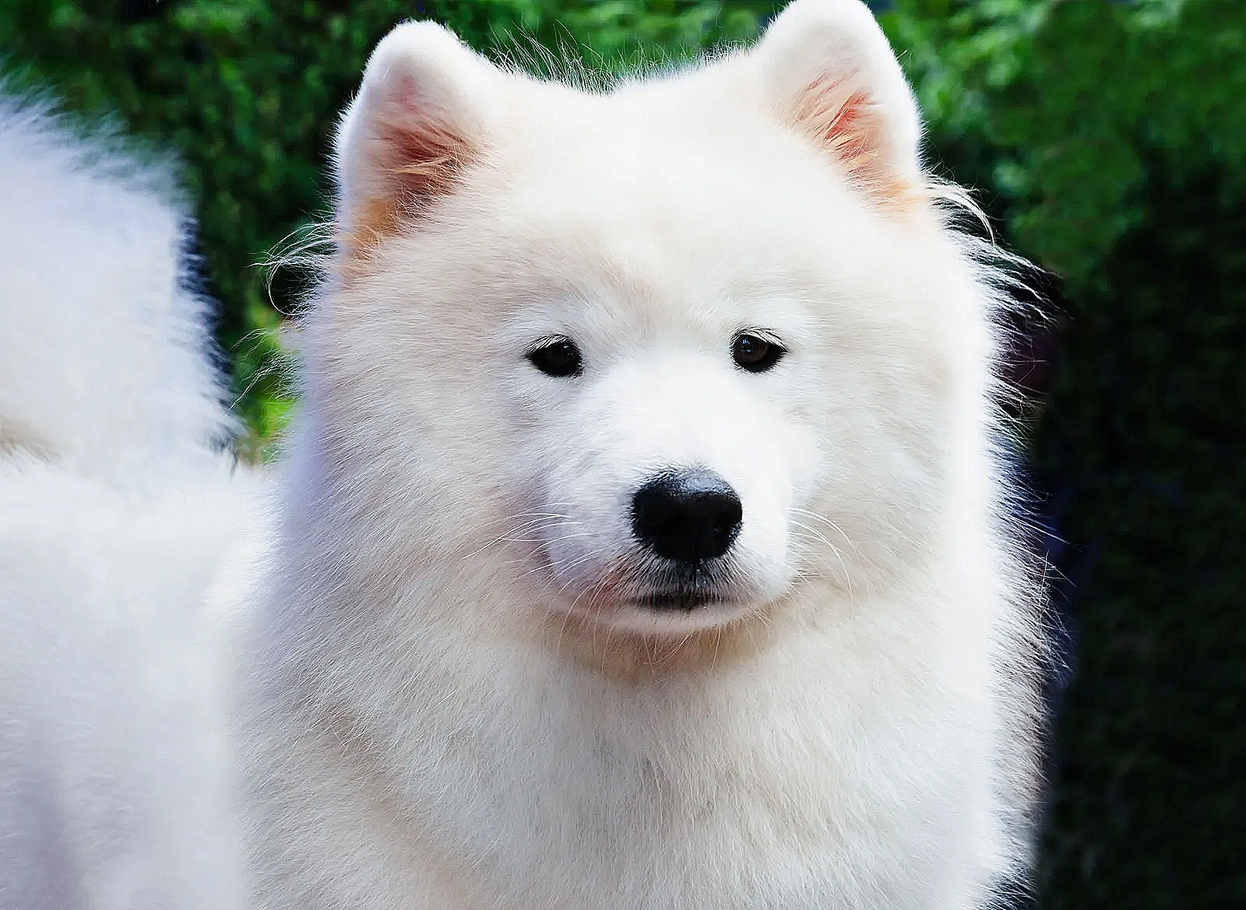

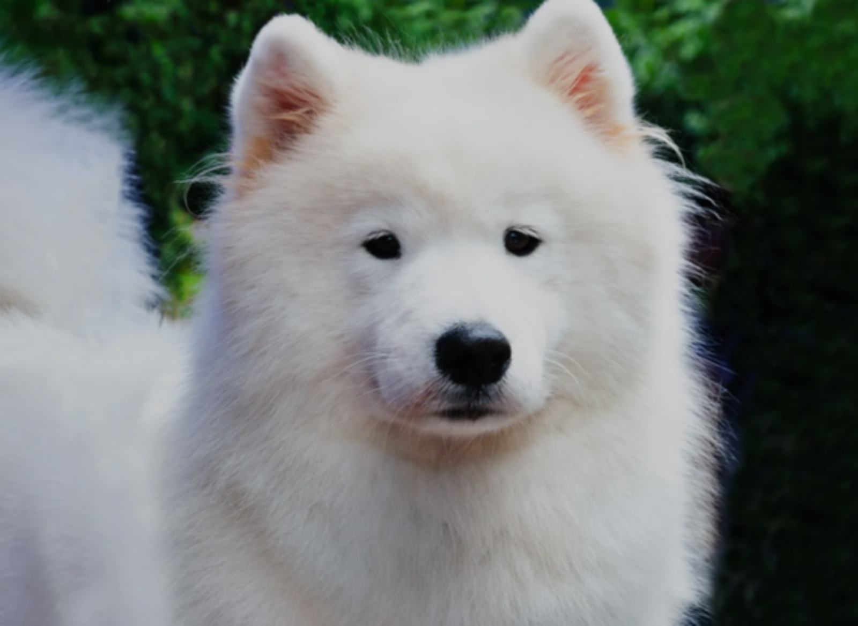
2d-filtering with different kernels
Sharpen
Box Blurring
Zero Kernel Blurring

Slide 7
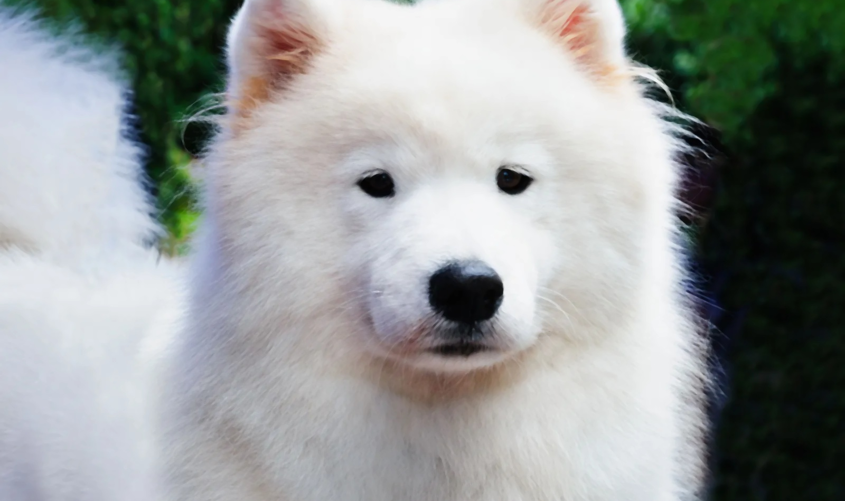
Median Filter

Slide 8
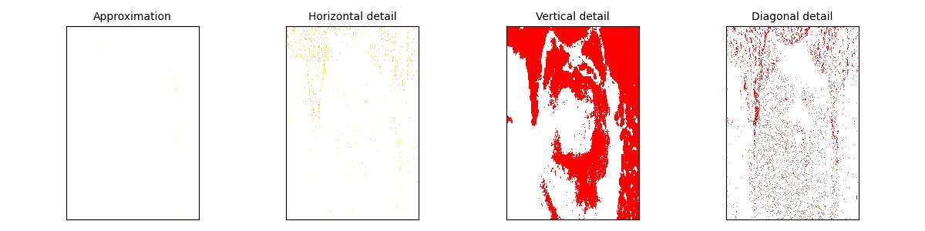
Wavelet Transform

Slide 9
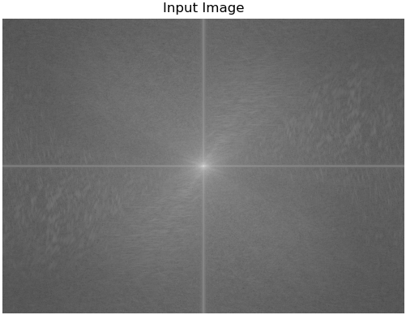
Fourier Transformation

Slide 10
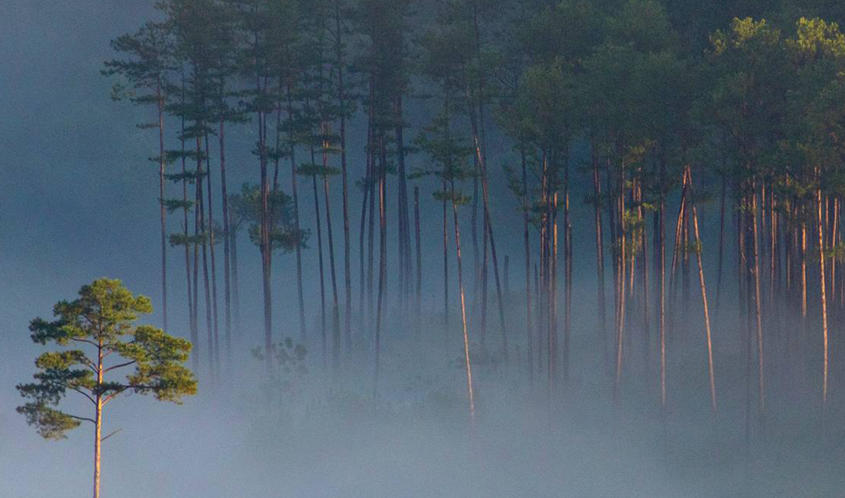
Thank you for attention!

